Slide 1

Mapping in R: Climate Projections
Addressing the necessary procedure to create thematic maps

Slide 2
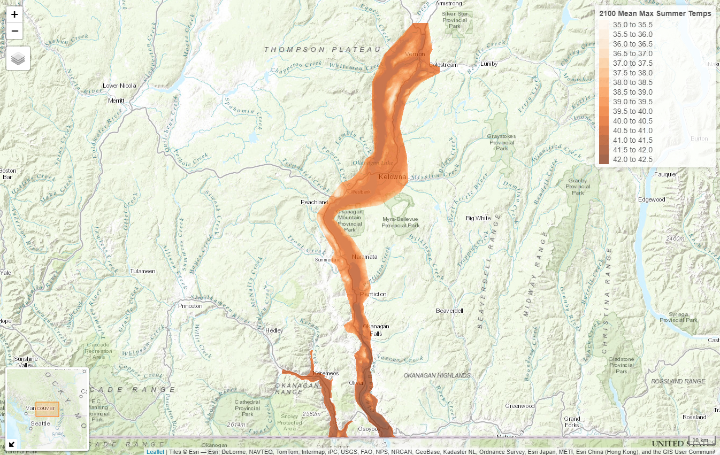

Slide 3
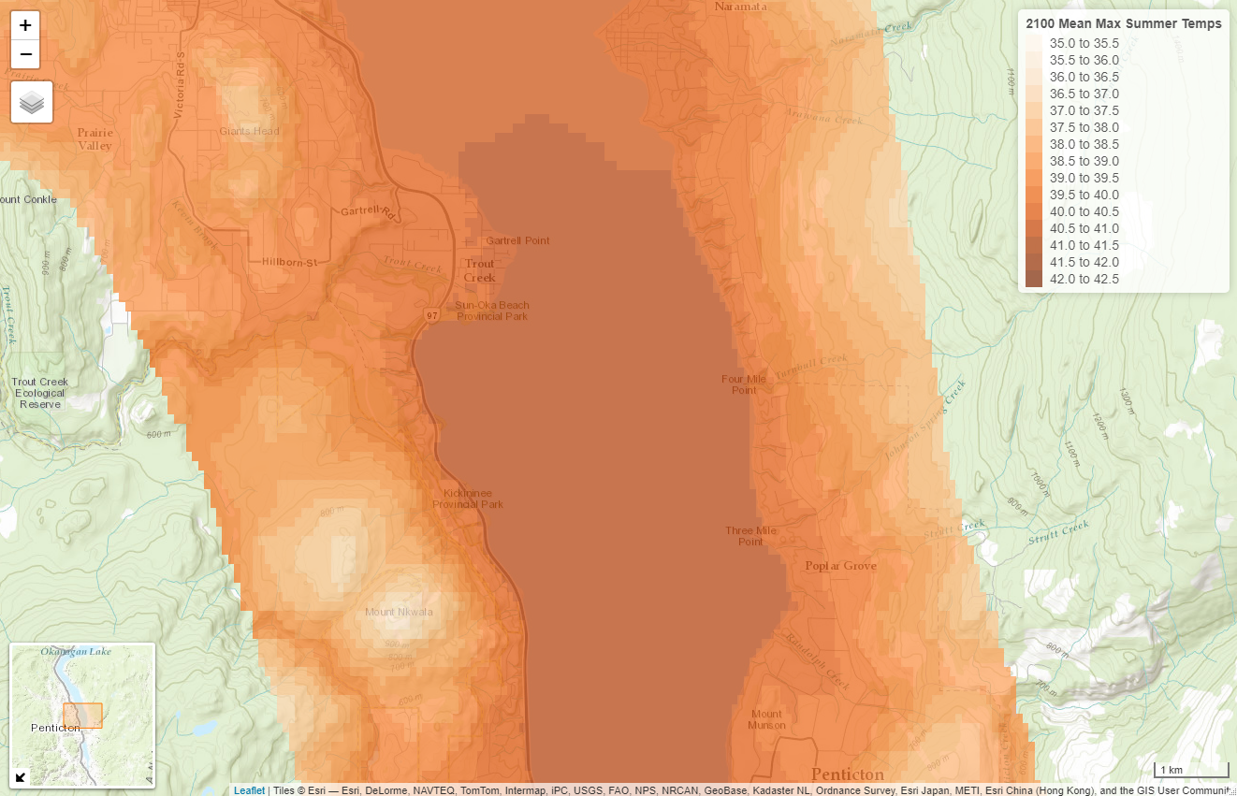

Slide 4
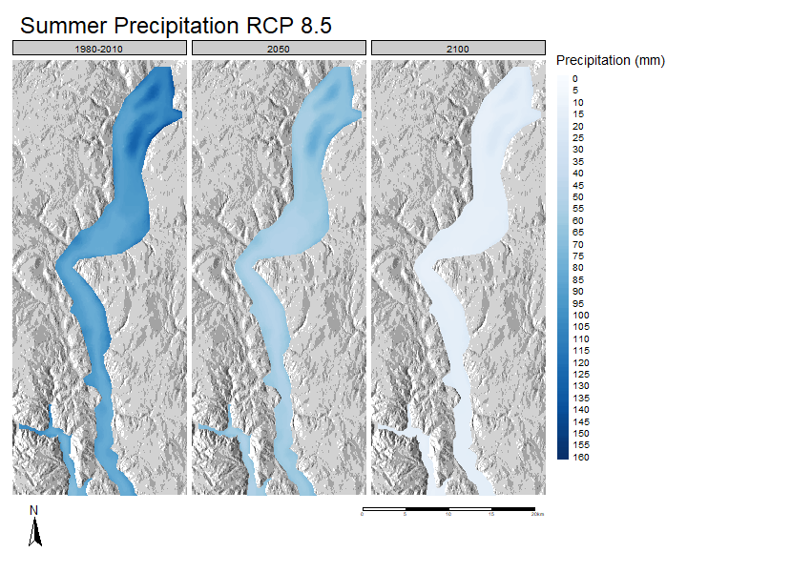

Slide 5
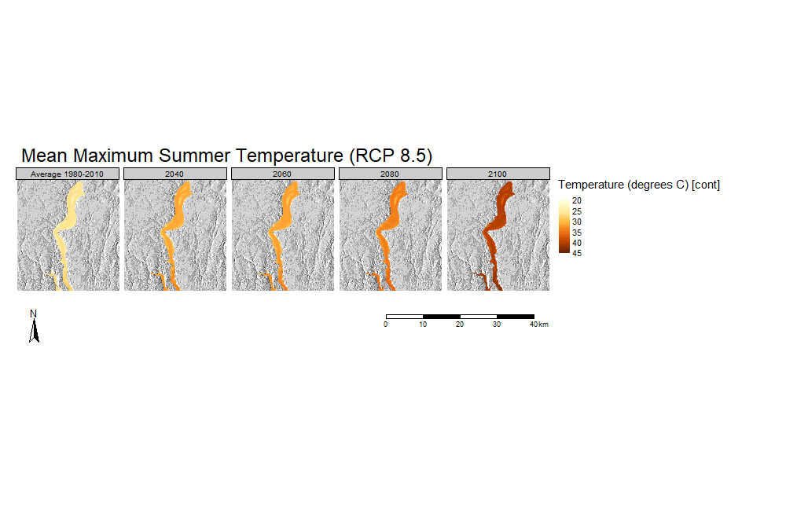

Slide 6
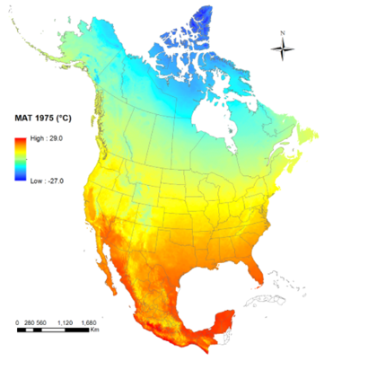
Climate Projections
Predicted climate variables according to a variety of different General Circulation Models (GCMs)
Many temperature and precipitation projections
for future years
Thanks to ClimateBC/ClimateNA
UBC faculty, Dr. Tongli Wang’s program
Input: Digital Elevation Models (DEMs)
.asc, .csv
Output: seasonal or annual projections

Slide 7
Packages
“tmap”
“tmaptools”
“raster”
“rgdal”
“rgeos”
“sp”

Slide 8
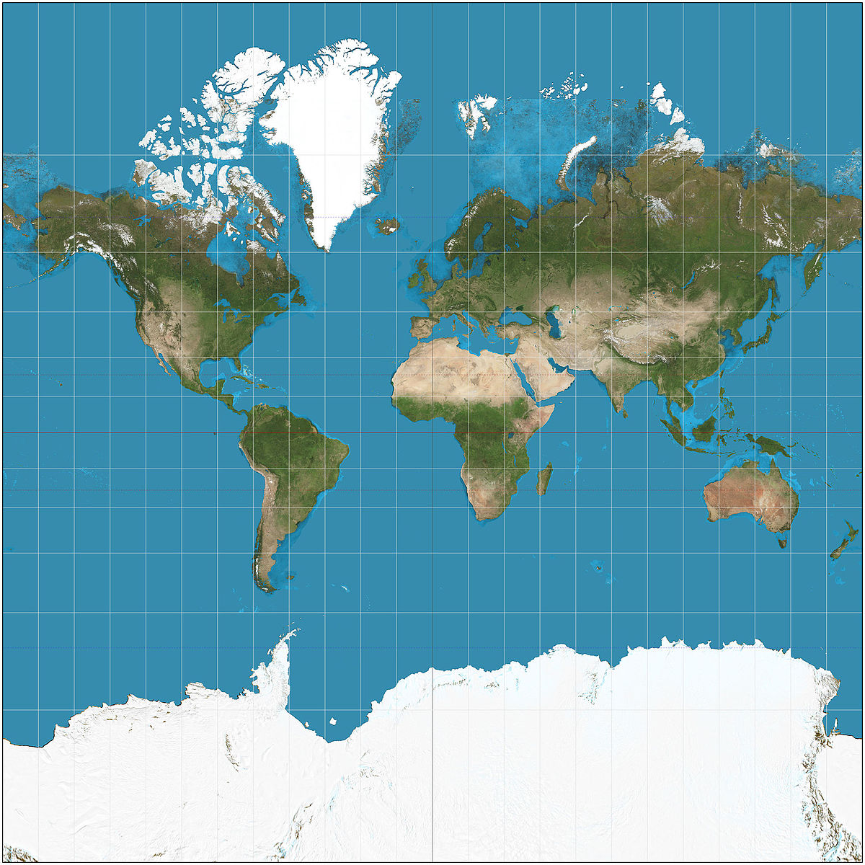
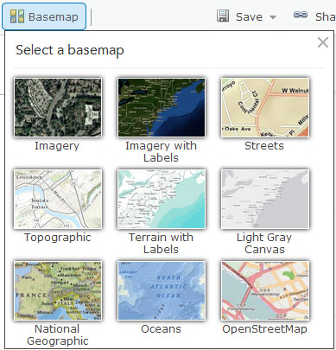

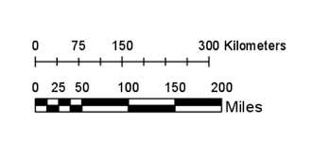
map components
Data
Basemap (optional)
Legend
Scale bar/compass
Map projection

Slide 9
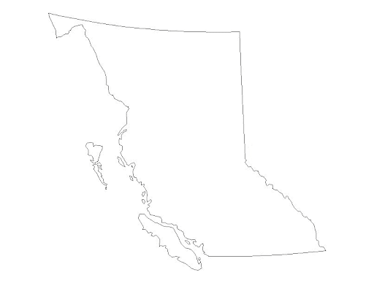
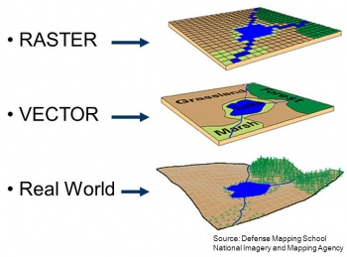
Vector & Raster Data
Vector
Points, lines, polygons
Discrete
Can contain useful 2D data: distance and area
File Type: KML, KMZ, shp
Raster
Grid of uniform cells
Continuous
Resolution (size of each cell) determines precision
Can display temperature, elevation, and RGB images
File Type: asc, tiff, png

Slide 10
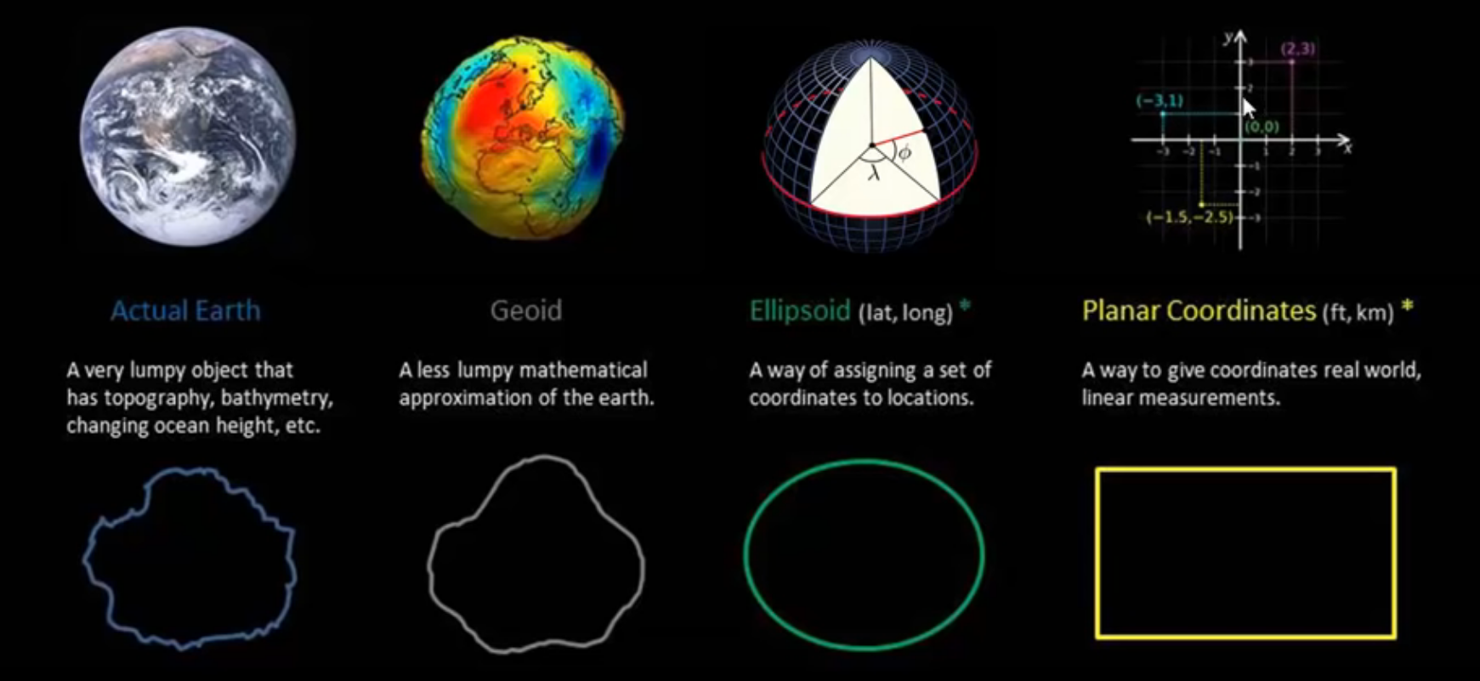
Reference/coordinate Systems
data is related to each other spatially with reference systems
Many types of Geographic and Projected Coordinate Systems
For simplicity, stick to WGS 84 and plot in latitude & longitude
Data must be in the same coordinate system to plot correctly
https://www.youtube.com/watch?v=Z41Dt7_R180

Slide 11
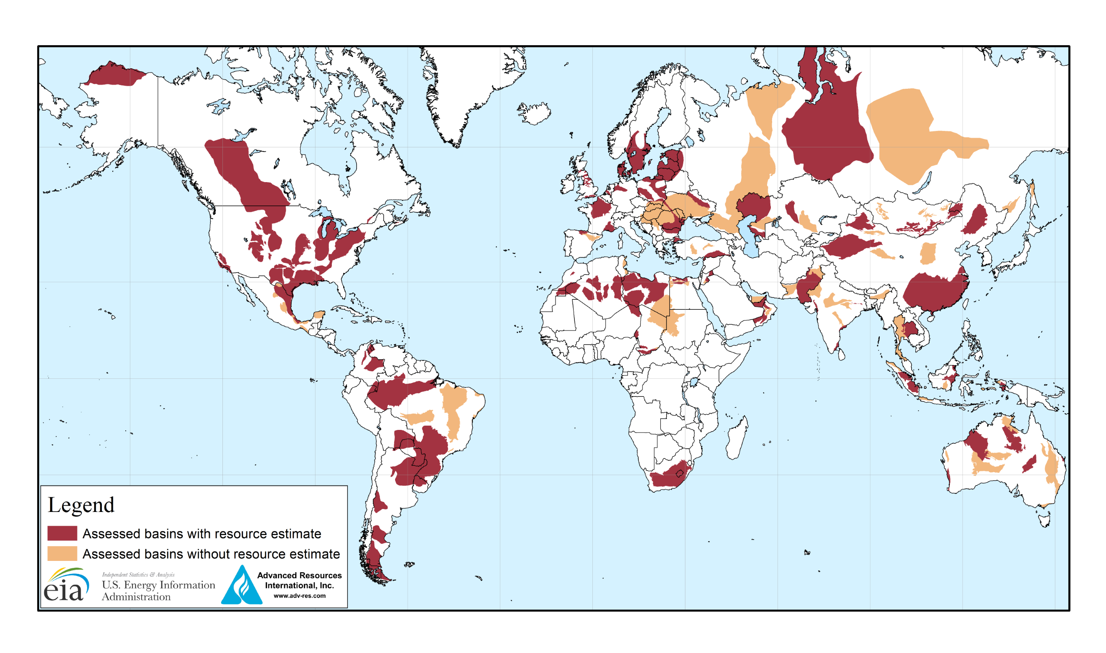
Alaska is 1.718 million square km
Brazil is 8.511 million square km

Slide 12
Map making steps
Data Acquisition
USGS
Data Analysis / Manipulation
Cropping
Plotting
Package: “tmap”
Maps Canada
Municipality GIS repository
Extracting slope from elevation models
Adjusting scale/units of data
Appropriate legends
Scale bar / compass
Map extent

Slide 13
Data Acquisition: Useful websites
Canada:
DEMs can be retrieved from https://maps.canada.ca/czs/index-en.html
They have a very intuitive website and have the option to import .shp files to get DEMs
Can download as .asc
Outside of Canada:
USGS (https://earthexplorer.usgs.gov/)
Less intuitive due to the mass amounts of datasets
Worldwide (although climate data is restricted to North America from ClimateBC/NA
Only useful file type for DEM for our purpose is .tif
Must convert to .asc in R
Some datasets are only accessible as multiple files
Would have to download all 4 orange squares to get the
green shape
1
2
.shp of interest
3
4

Slide 14
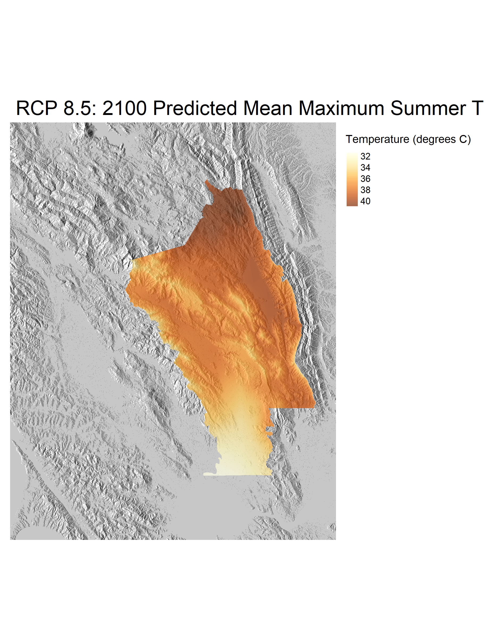
Map walkthrough: Napa, Ca
1) Data Acquisition: DEM & RCP 8.5 Climate Projections
II) Data Manipulation: cropping, rescaling, creating hillshade
III) Plotting: using the functionality of “tmap” to plot informative and aesthetic maps

Slide 15
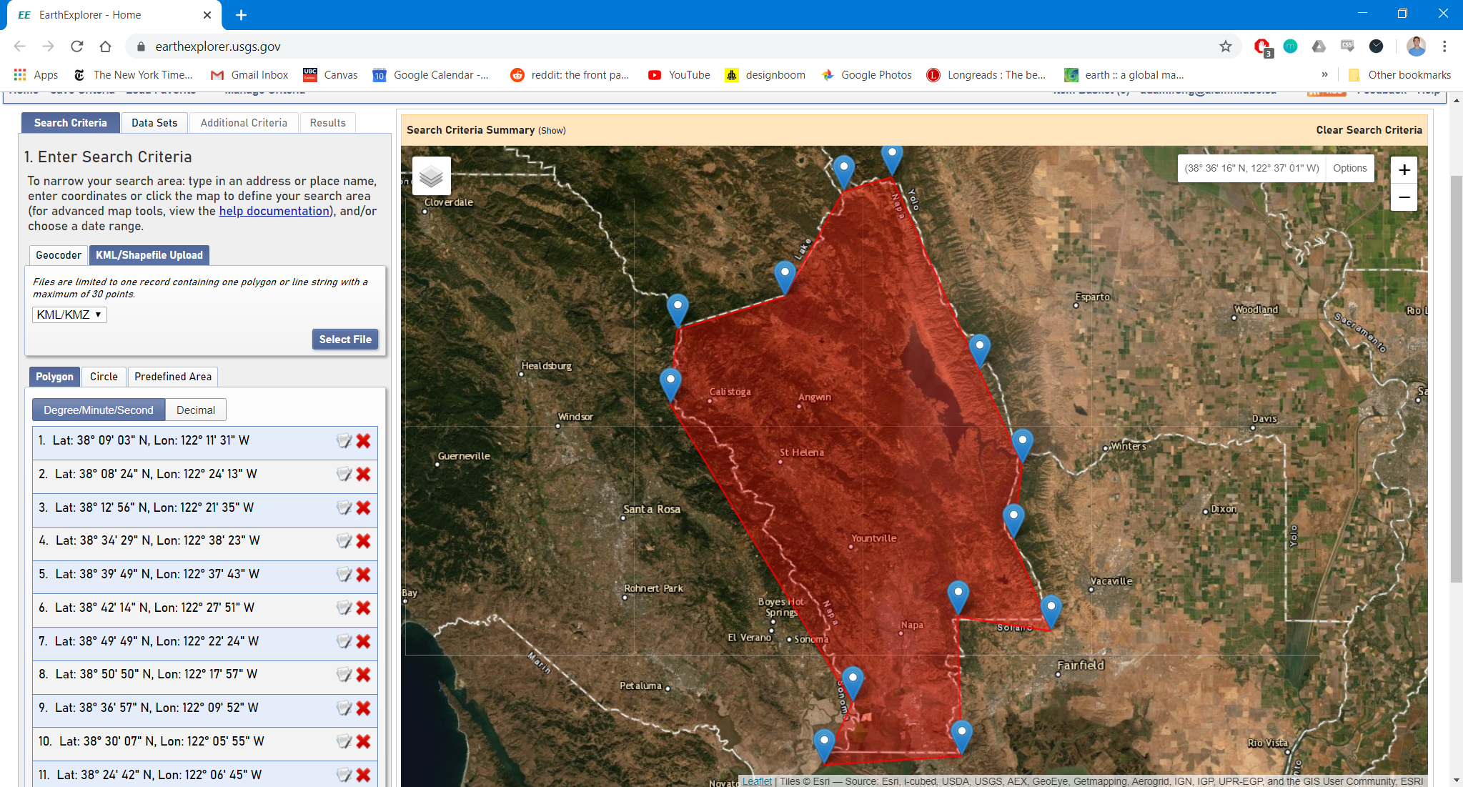
Data Acquisition: DEM from USGS

Slide 16
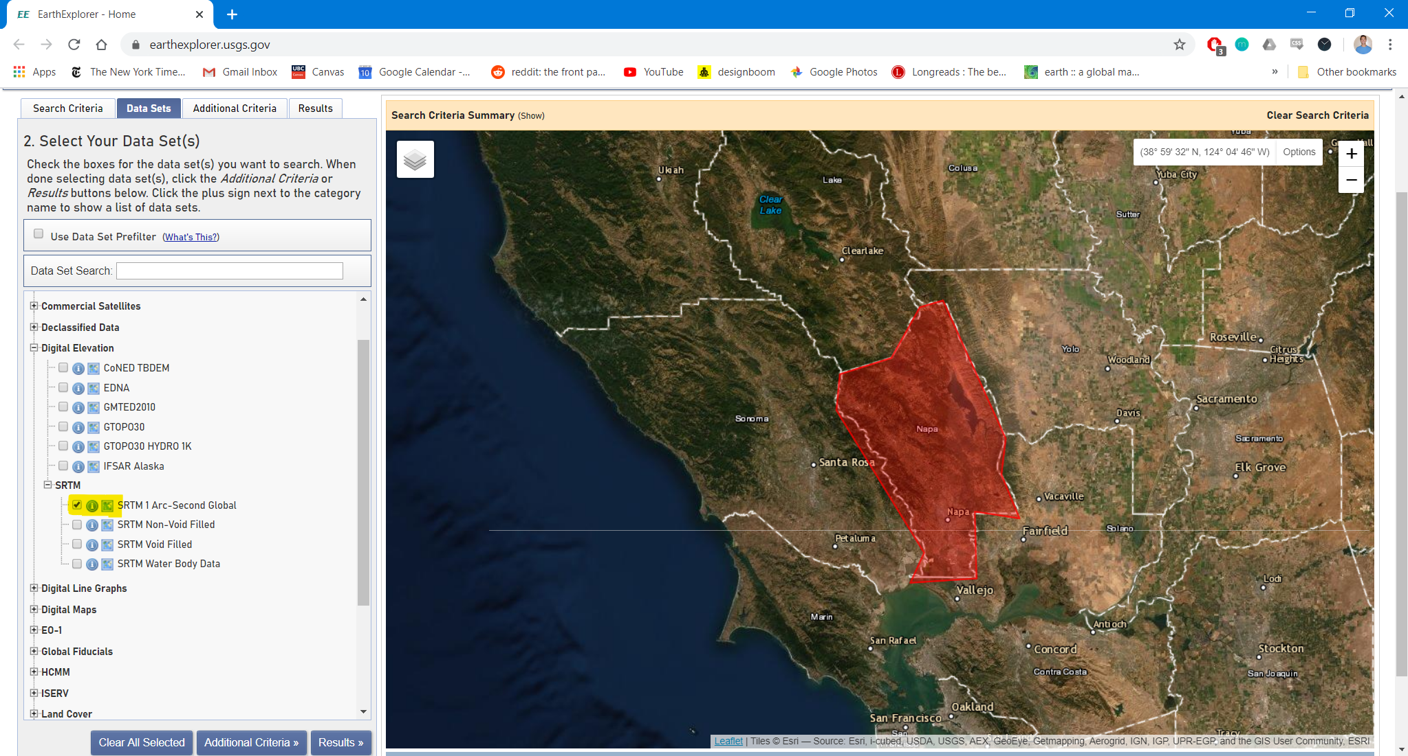
Data Acquisition: DEM from USGS

Slide 17
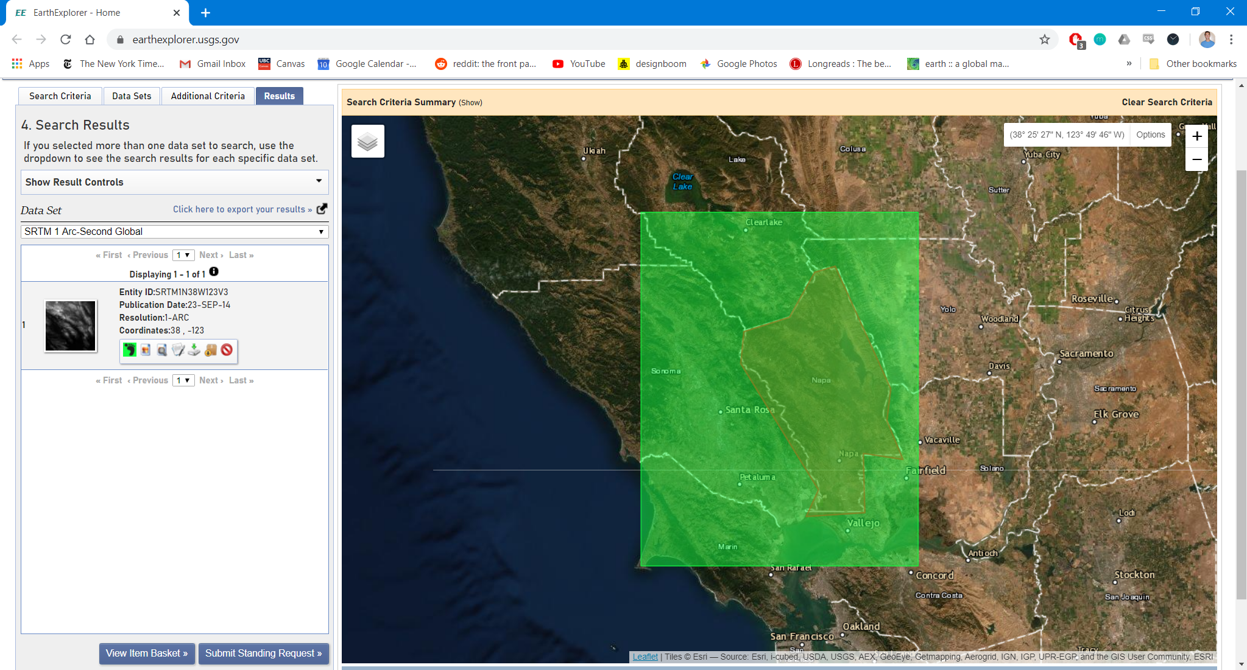
Data Acquisition: DEM from USGS
Napa DEM 1 arcsecond resolution: napa_1arc.tif aka NapaDEM.tif

Slide 18
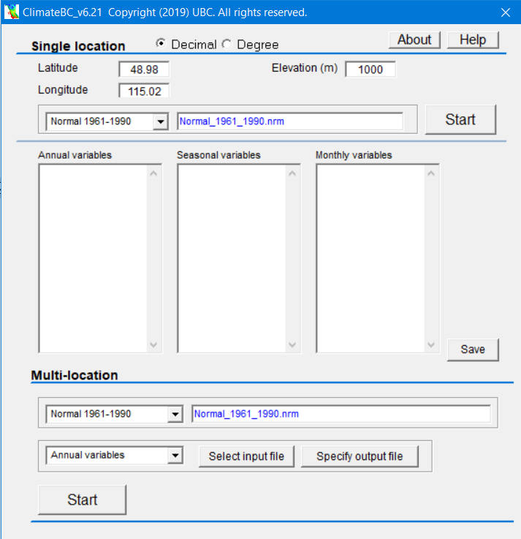
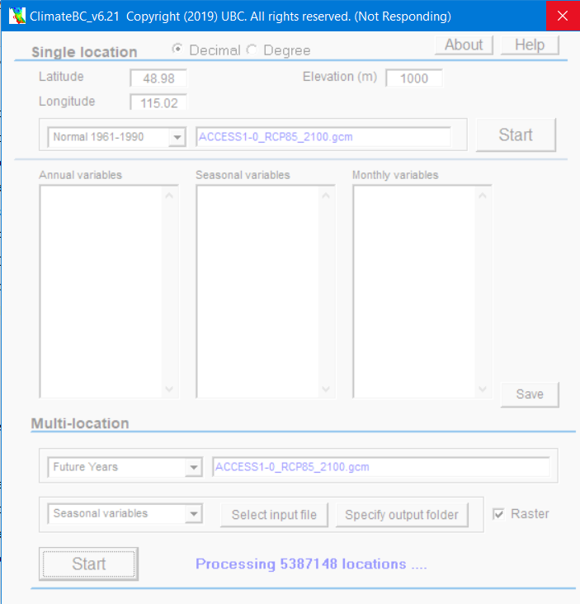
Data acquisition: climate projections
I then downloaded a .shp file of Napa Country through a Berkeley data archive
I cropped the DEM.tif file with the border of the county and converted the file to .asc

Slide 19
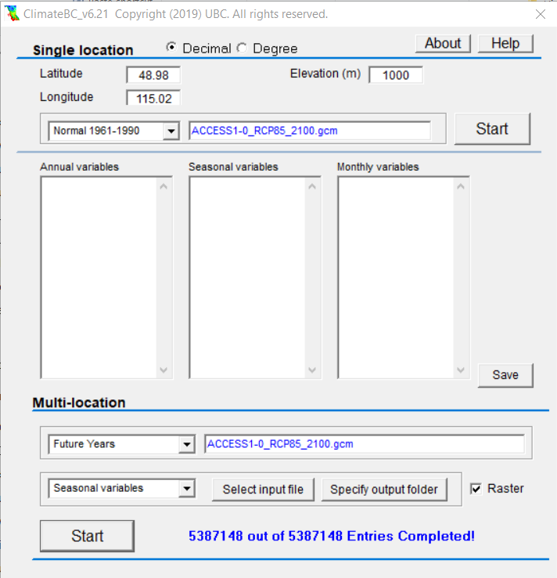
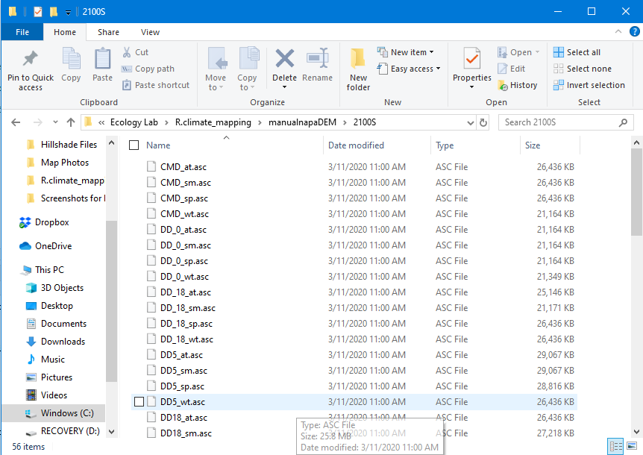
Data acquisition: climate projections
Fine resolution DEMs make this lengthy
This 1 arc second file took about 1.5 hours to process (in ClimateNA)
Current Dataset:
Tmax_sm.asc
NapaDEM.tif

Slide 20
Data Manipulation: rescaling temperatures
Tongli’s program scales temperature data by a factor of 10
The temperatures must be rescaled to plot
Tmaxnapa2100 <- raster("manualnapaDEM/2100S/Tmax_sm.asc")
Tmax_plot <- overlay(Tmaxnapa, fun = function(r1){r1/10})
Temperatures are ready to plot

Slide 21
Data Manipulation: hillshade basemap
Use the NapaDEM.tif file to extract two files: slope & aspect
Combine these two files into a hillshade using the function hillShade()
crs(napaDEM)
slope <- terrain(napaDEM, opt="slope")
aspect <- terrain(napaDEM, opt="aspect")
hillshade <- hillShade(slope, aspect, 40, 270)
“raster”
tmap_mode("plot")+
tm_shape(hillshade)+
tm_raster(palette = grey(0:100/100),
legend.show = FALSE)
Confirm the hillshade looks correct by plotting

Slide 22
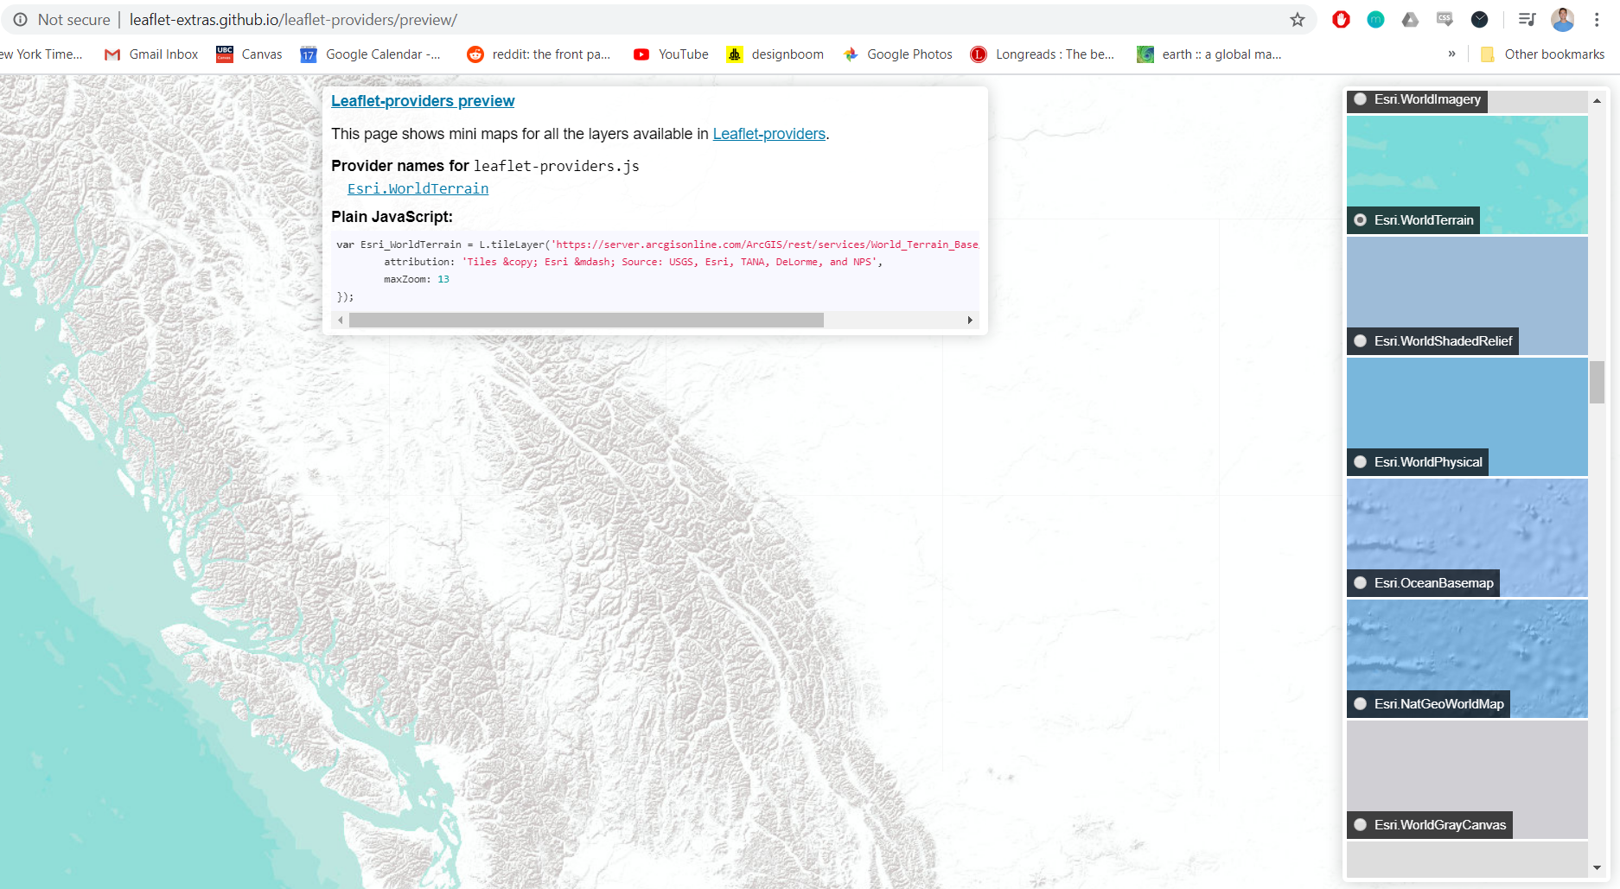
Plotting: “tmap” modes
“tmap” has two modes of displaying data: “view” and “plot”
View is used to make interactive maps that can be panned, zoomed into, and toggle data on and off
Good for zooming in on locations
Can plot basemaps from https://leaflet-extras.github.io/leaflet-providers/preview/
ESRI maps included (surprisingly)
Only available in Mercator Map Projection
Mostly fixed aesthetic
Most effective showing one dataset
Plot creates static maps that are effectively photos
Difficult to find/plot fine resolution basemaps beyond hillshades
Great for creating faceted maps to compare time frames

Slide 23
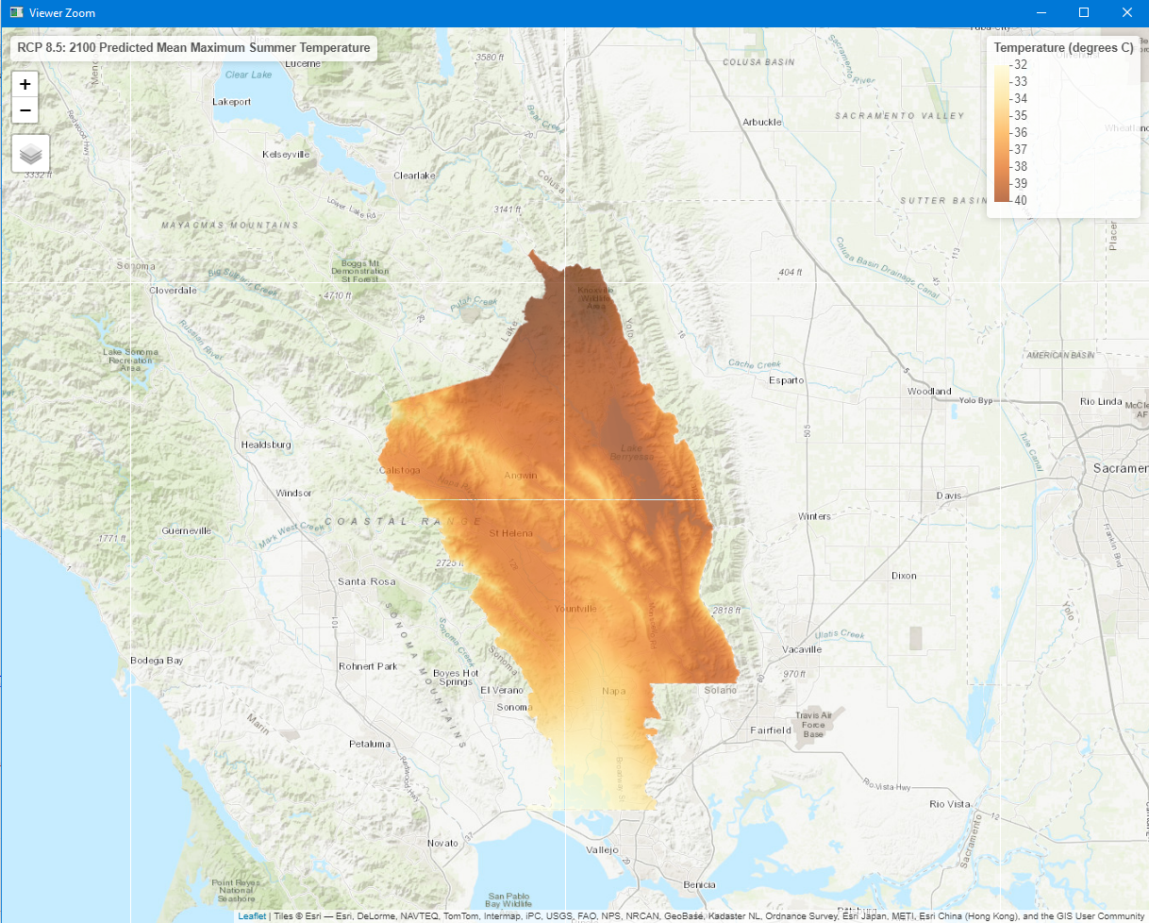
Plotting: tmap_mode(“view”)
Interactive file:
Script:
napatopoview <- tmap_mode("view")+
tm_basemap("Esri.WorldTopoMap")+
tm_shape(Tmax_plot)+
tm_raster(title = "Temperature (degrees C)", style = 'cont', alpha = .7)+
tm_layout(title = "RCP 8.5: 2100 Predicted Mean Maximum Summer Temperature", legend.outside = TRUE, frame = FALSE)

Slide 24
Plotting: tmap_mode(“plot”)
Script:
napahsplot <- tmap_mode("plot")+
tm_shape(hillshade)+
tm_raster(palette = grey(0:100/100), legend.show = FALSE)+
tm_shape(Tmax_plot)+
tm_raster(title = "Temperature (degrees C)", style = 'cont’, alpha = .7)+
tm_layout(main.title = "RCP 8.5: 2100 Predicted Mean Maximum Summer Temperature", legend.outside = TRUE, frame = FALSE)

Slide 25
Functionality beyond the walkthrough
View mode
Many different basemaps
Scale bar
Additional, toggleable, datasets
Minimap
Faceted maps
Plot mode
Faceted maps
North arrow
Legends
Data categorization
Only displaying selected data
Data suppression
Raster Math
Comparing different years
Normalizing data

Slide 27
References
ClimateBC –
Wang T, Hamann A, Spittlehouse D, Carroll C (2016) Locally Downscaled and Spatially Customizable Climate Data for Historical and Future Periods for North America. PLoS ONE 11(6): e0156720. doi:10.1371/journal.pone.0156720

